Slide 1
Ctrl+Z for Git: How to undo (almost) anything
@TobiahZarlez

Slide 2
GitHub
Repo
Codebase v3
Codebase v2
Codebase v1
Remote
1
Remote
2
Remote
3
Notes:
Can anyone tell me why this isn’t good?

Slide 3
How does Git actually work?
Fork1
GitHub
Base
GitHub
Fork1
GitHub
Repo
Repo
Repo
Local
Git
Local
Git
Local
Git
Repo
Repo
Repo

Slide 4
How does Git actually work? (Simple)
GitHub(origin)
Remote:
Repo
“Push” code from local, to remote
“Pull” code from remote, to local
Local
Git
Repo

Slide 5
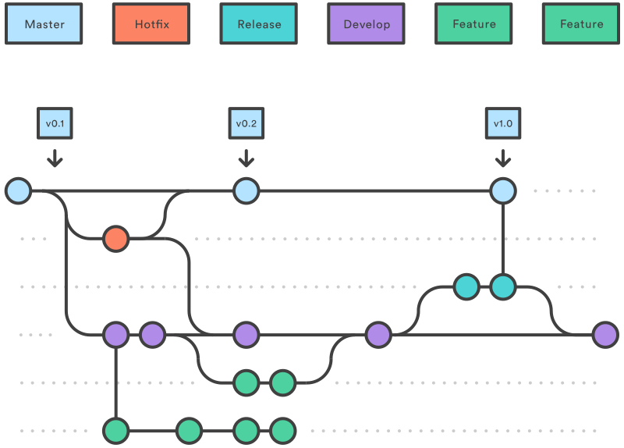
How does Git actually work?

Slide 6
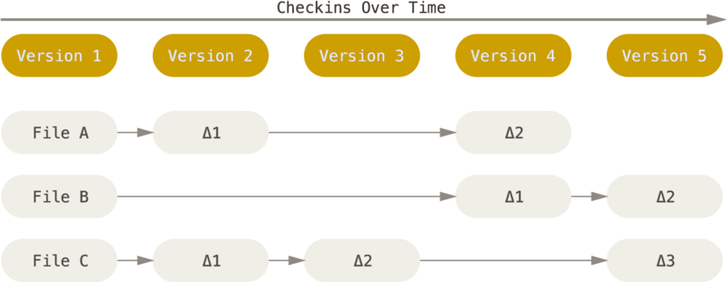
How does Git actually work?

Slide 7

Git is both simple and complicated

Slide 8


You too can be like these dogs!
Notes:
One of the things you need to do after all is git fetch

Slide 9

Warning: CLI ahead

Slide 10

The problem with using GUI tools

Slide 11

Let’s GIT started!

Slide 12

Git Revert: All you need!
Syntax: git revert <commit SHA>
Easy to do
No worries about changing history
Can revert the revert

Slide 13
Tracked Files
.gitignore
Syntax: git rm -r --cached <file>
Remove file
-R for recursion (if it is a folder)
--cached keep the file around, just stop tracking it
.gitattributes
For Git LFS

Slide 14
Discard Local Changes
Syntax: git clean –f
Removes untracked files
-f removes ignored files
Syntax: git reset --hard HEAD
git reset to a certain commit SHA
HEAD is the current branch/commit
--hard changes files

Slide 15
Undo Local Commits
Syntax: git commit –-amend
Fix the last commit
Syntax: git checkout <commit SHA> -- <file>
Undo changes to just that file
Syntax: git reset --hard <commit SHA>
git reset to a certain commit SHA
HEAD is the current branch/commit
--hard changes files

Slide 16
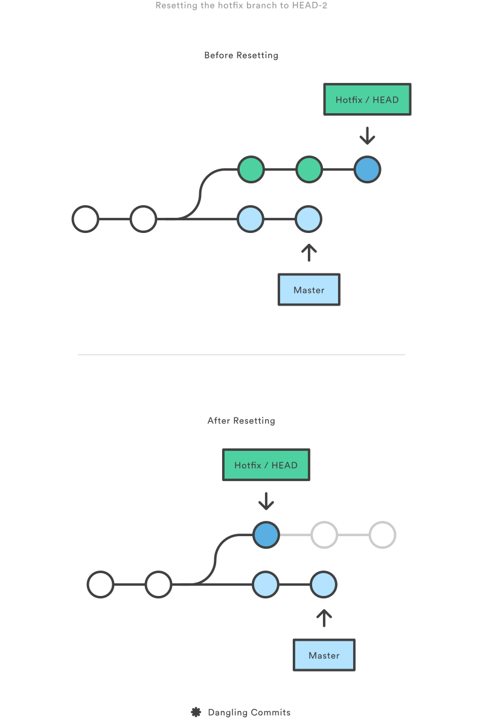
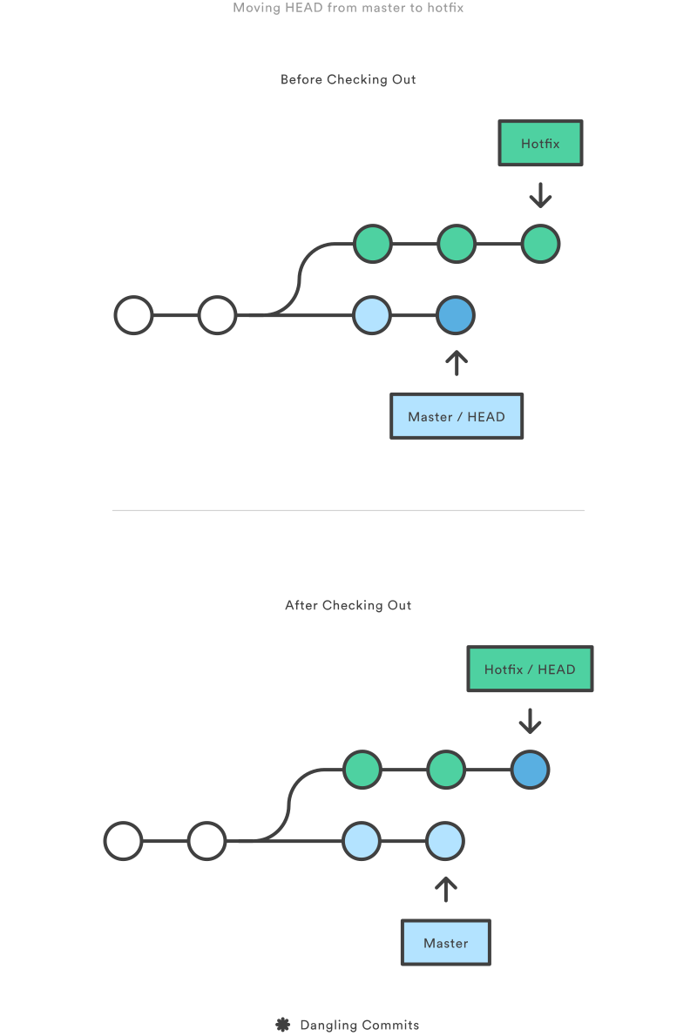
git reset
vs.
git checkout

Slide 17
Oops… Again!
Syntax: git reflog (+ git reset or git checkout)
Redo changes
Syntax: git cherry-pick <commit SHA>
Replay exactly one commit onto current branch

Slide 18
Committed to the wrong branch
Syntax: git branch feature, git reset --hard origin/master, git checkout feature
Create new feature branch, automatically same as master
Reset master branch to match origin/master (which doesn’t have pushed changes)
Checkout new feature branch, commits still intact.

Slide 19
Find the Bug
Syntax: git bisect start, git bisect bad, git bisect good <commit SHA> git bisect good / git bisect bad
Start the bisect process
Mark the current commit as bad
Mark the last known good commit
Will check out somewhere in between, you test, then mark good/bad

Slide 20

What if I want to change history?

Slide 21
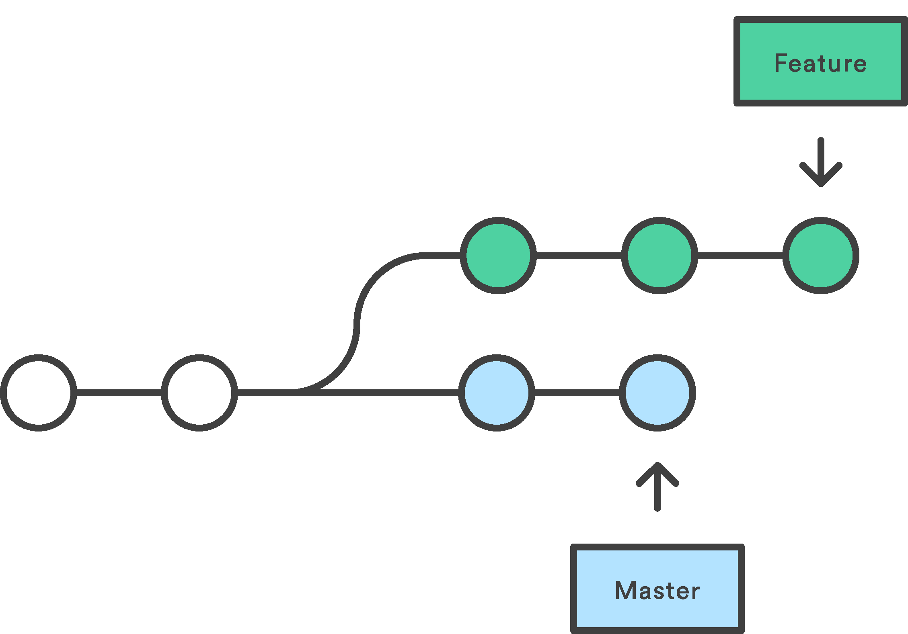
Merge vs. Rebase

Slide 22
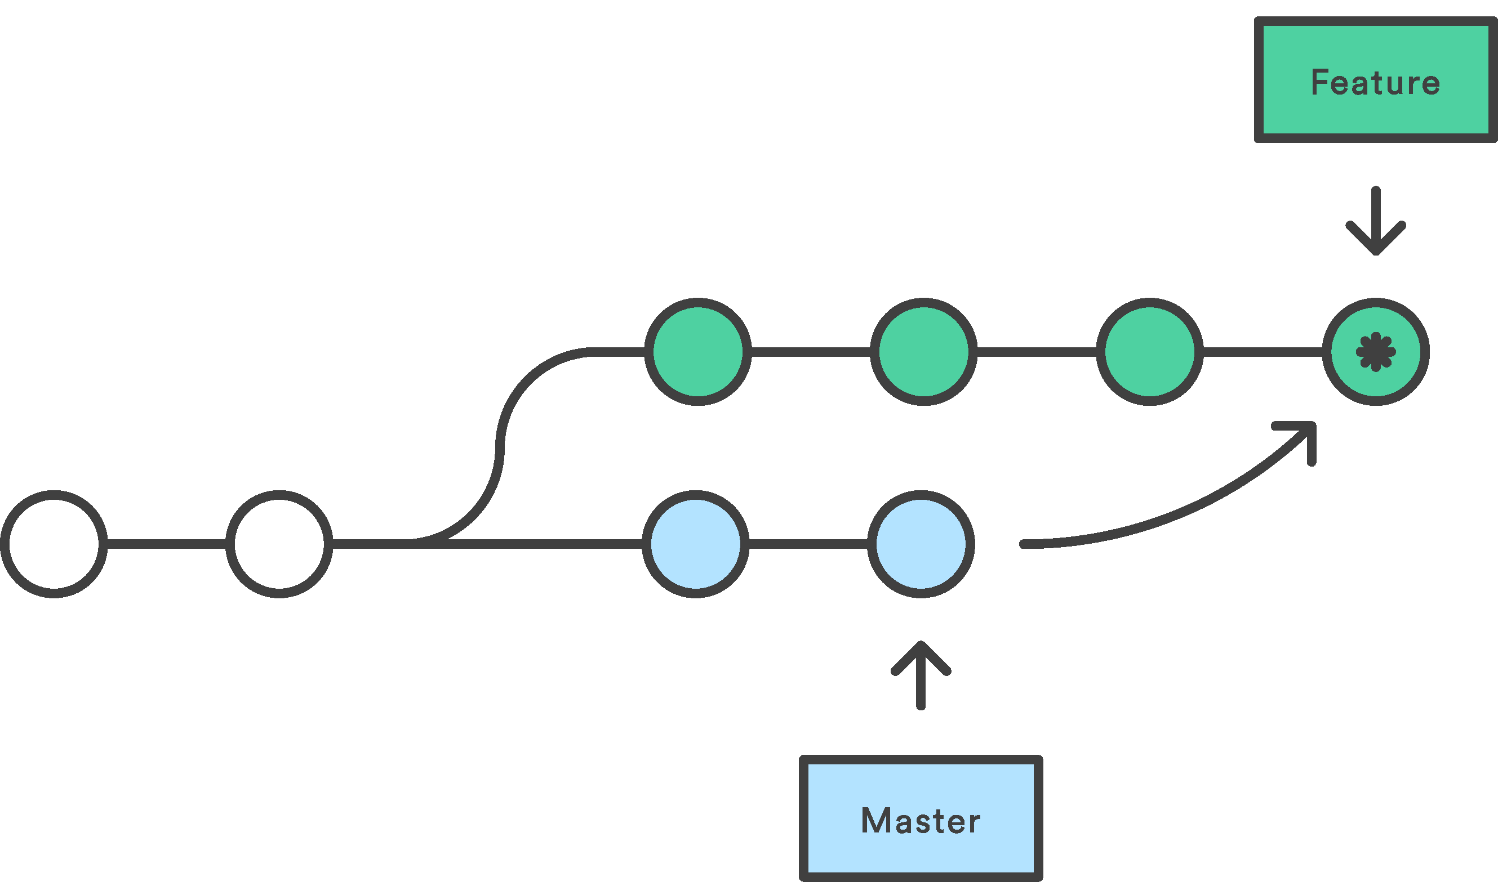
Merge
Syntax: git checkout feature, git merge master

Slide 23
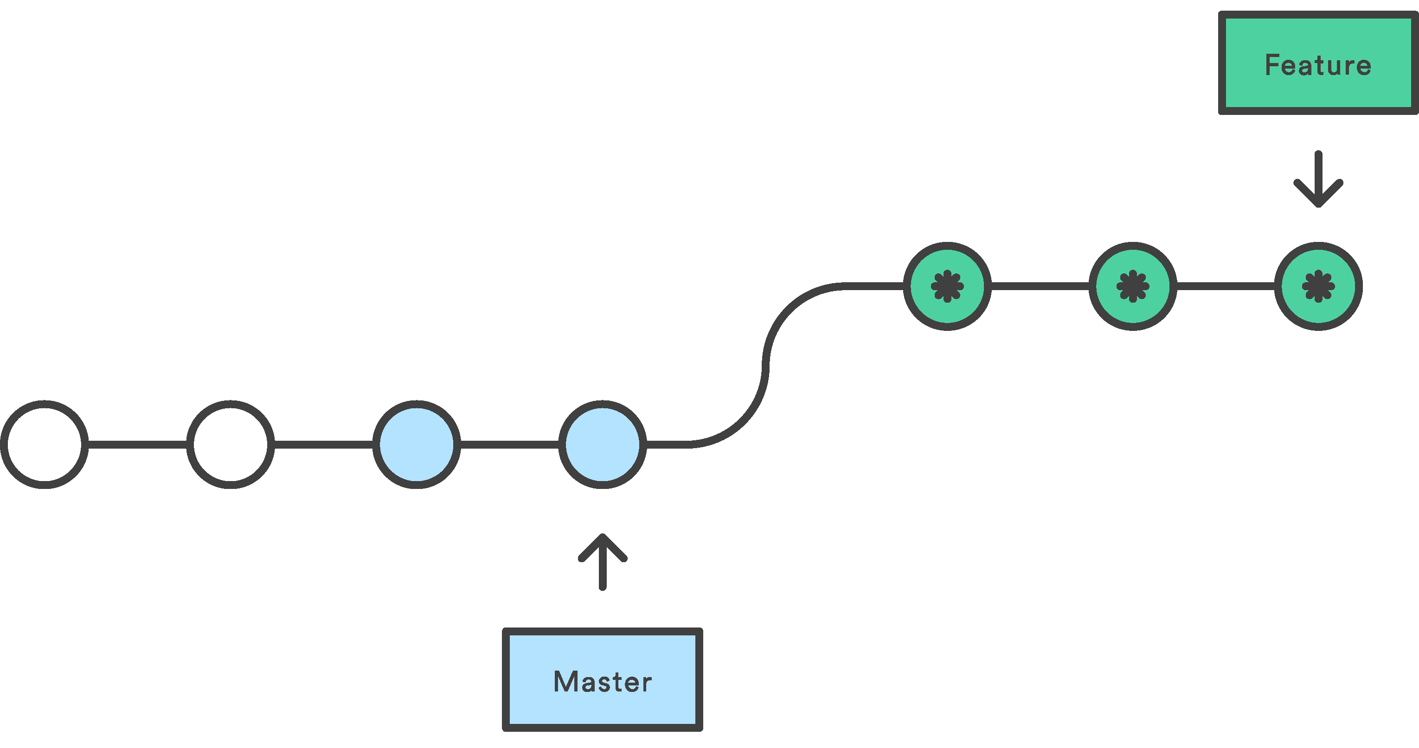
Rebase
Syntax: git checkout feature, git rebase master

Slide 24

Don’t change shared history

Slide 25
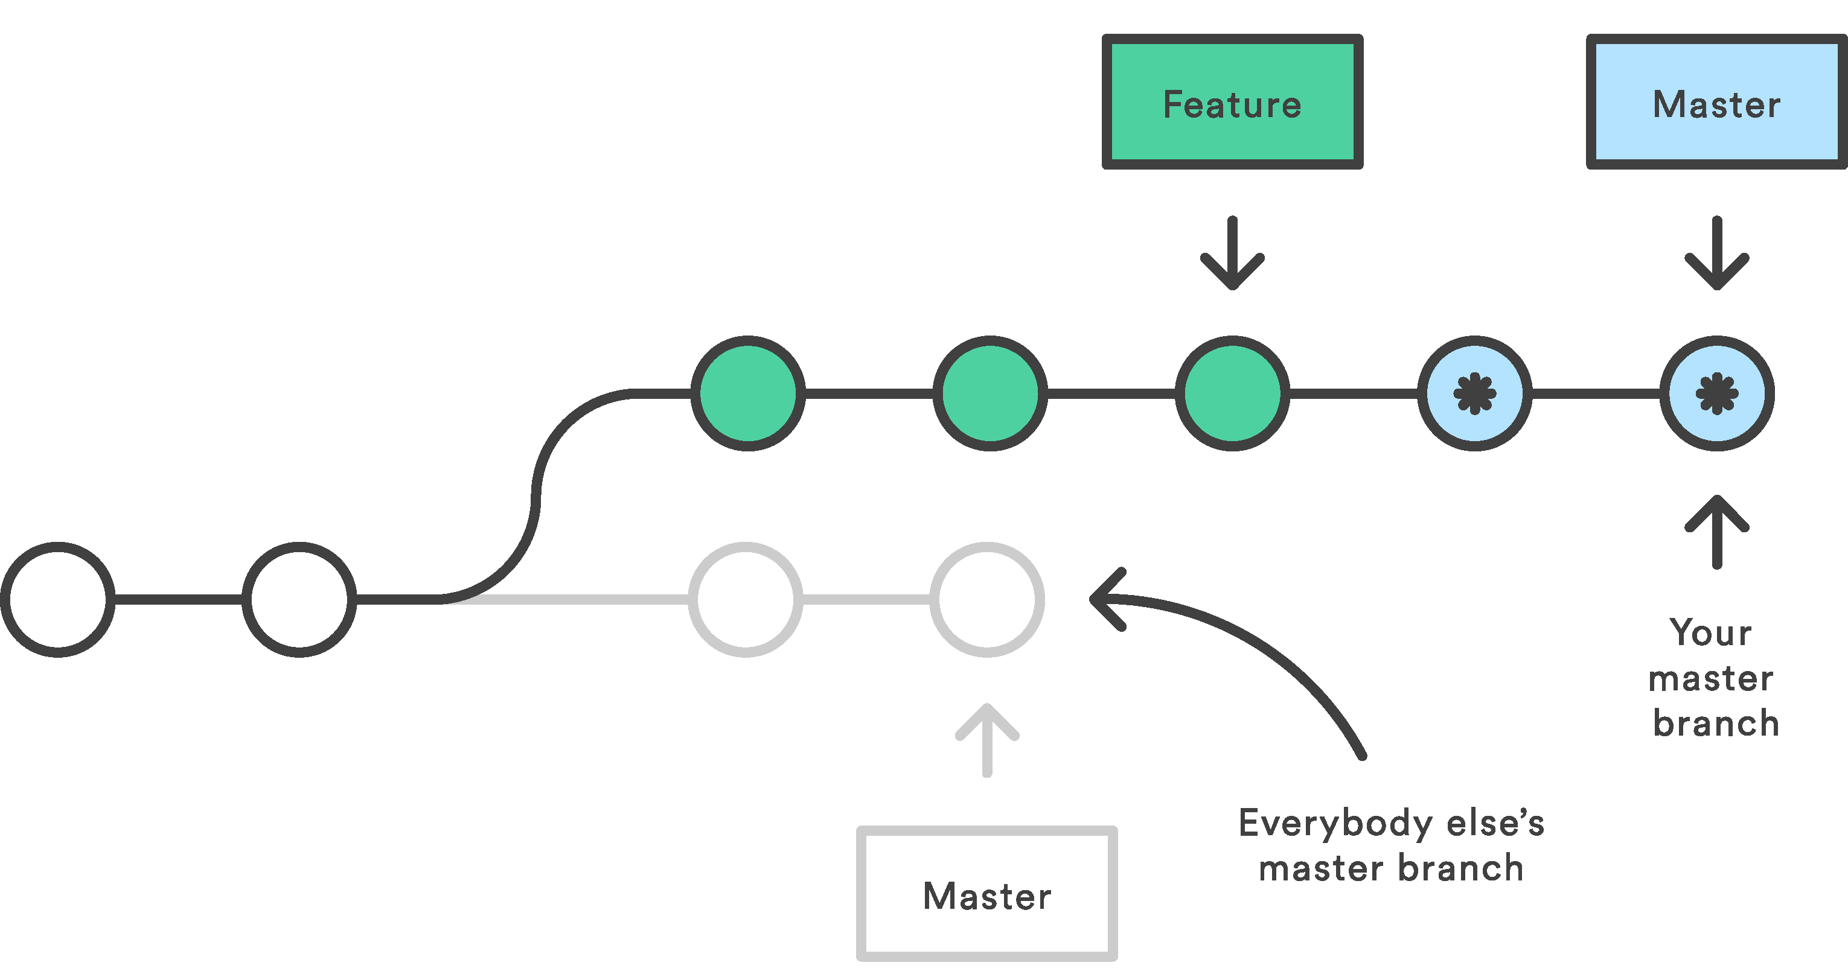
Danger of Rebase
Syntax: git checkout master, git rebase feature

Slide 26
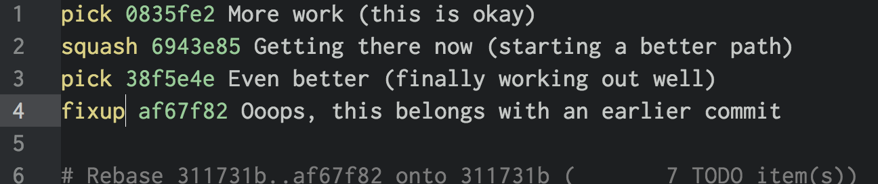
Change Improve History
Syntax: git rebase -i <earlier SHA>
Rebase from an earlier commit
-i is an interactive rebase
You chose: Pick, Reword, Squash, Fixup, Change the order!

Slide 27
Do it automatically!
Syntax: git commit --squash <earlier SHA>, git rebase –autosquash –i <even earlier SHA>
Same as before, but automatically moves --squash commit to just after <earlier SHA> and marks for squashing

Slide 28
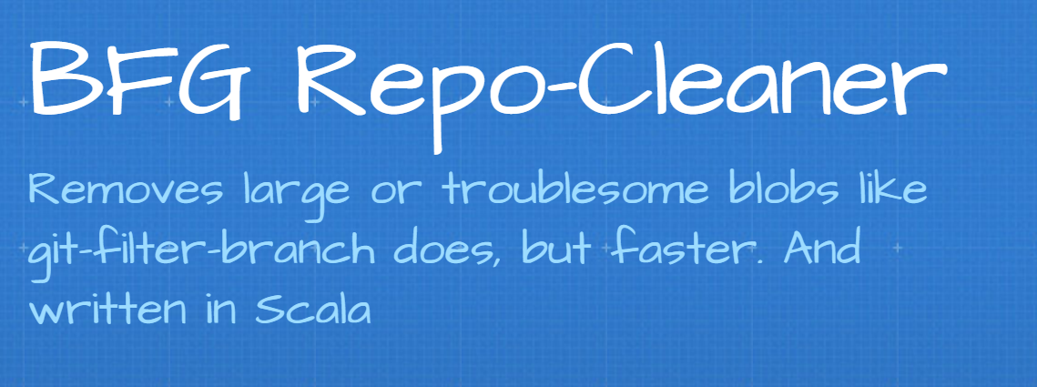
Delete History
Committed a password?
Commit too large of files?
https://rtyley.github.io/bfg-repo-cleaner/

Slide 29

Git-LFS for binary files
Notes:
GitHub
1gb Storage and 1gb bandwidth
$5 a month for 50gb more
Visual Studio Team Services:
Free unlimited

Slide 30
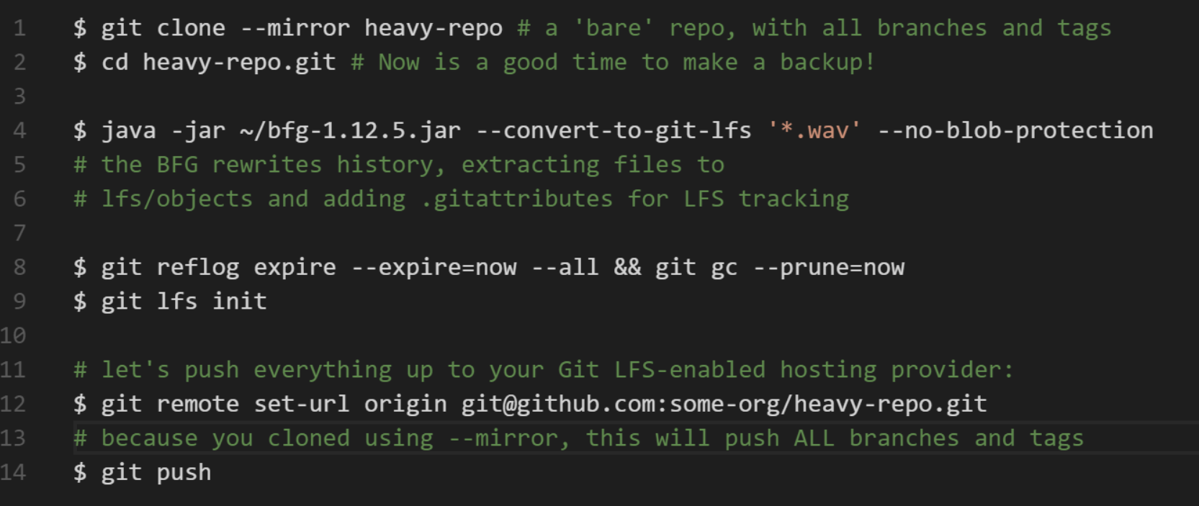
Convert to git-lfs
https://github.com/rtyley/bfg-repo-cleaner/releases/tag/v1.12.5

Slide 31
What about public history?
Notes:
Can you change public history?

Slide 32

How to (and best practices) for changing public git history

Slide 33
Resources
Questions?
My info:
@TobiahZarlez
www.TobiahZ.com
Slides
https://github.com/TobiahZ/CtrlZforGit
Software/Tools
Git-LFS - https://git-lfs.github.com/
VSCode - https://code.visualstudio.com/
Meld - http://meldmerge.org/
Repositories
GitHub's Git Ignore repository - https://github.com/github/gitignore

